Slide 1
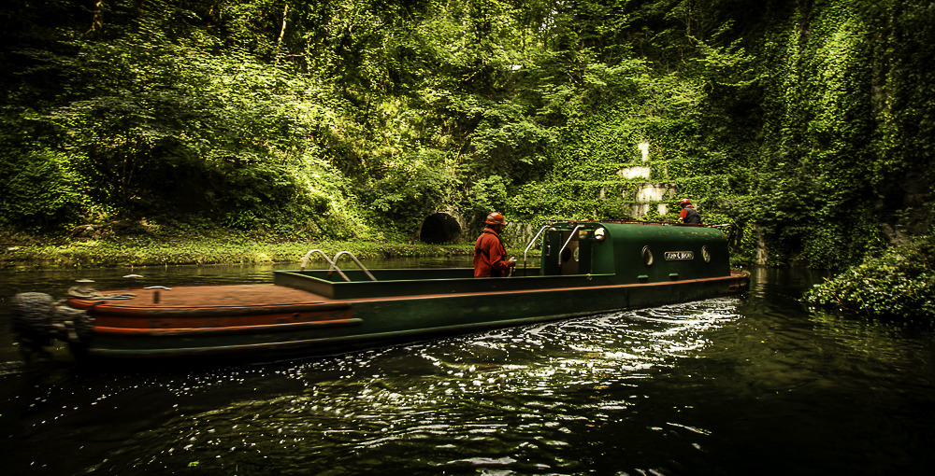
2024 Annual General Meeting
Dudley Canal and Tunnel Trust

Slide 2
Agenda
Apologies
Chairman’s Welcome
Chairman’s Report
Chief Executive’s Report
Treasurers Report
Vote - Accountants
Closing Statement

Slide 3
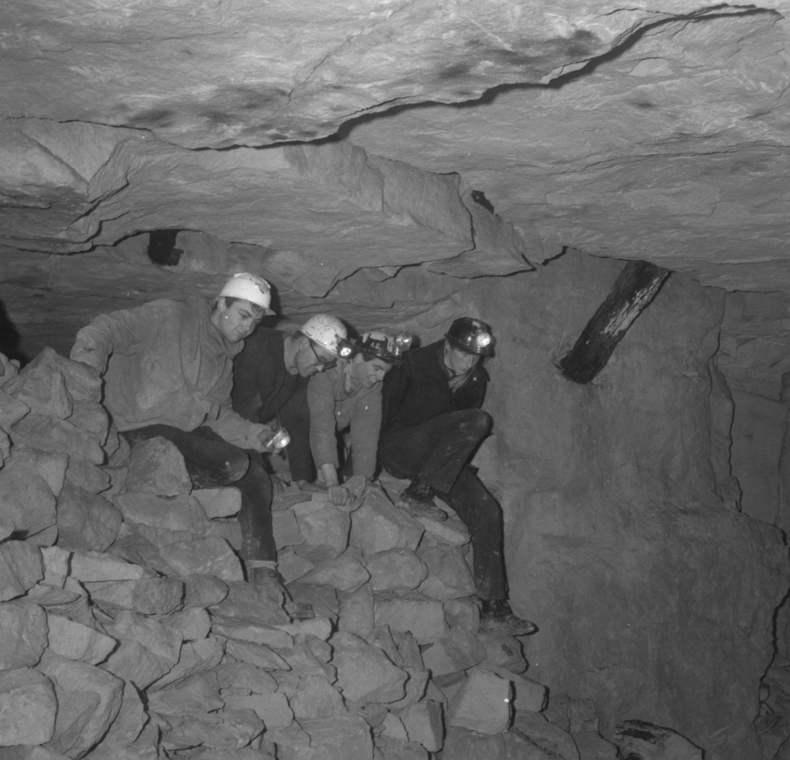
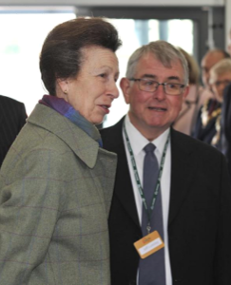
Chairman’s Welcome
In Memorial
Mr Jeff Luesley

Slide 4
Chairman’s Report
Annual General Meeting
Chair Position
Volunteers
Trustees

Slide 5
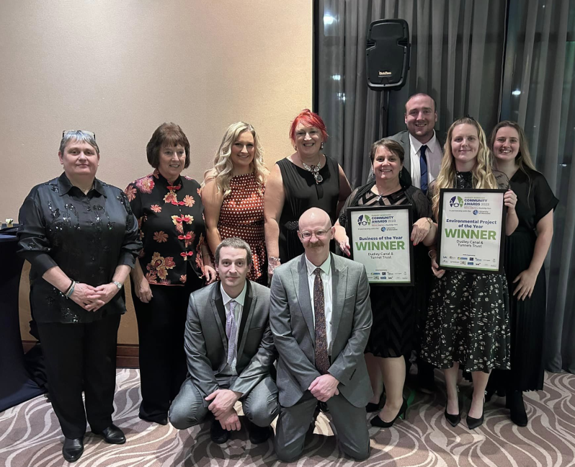
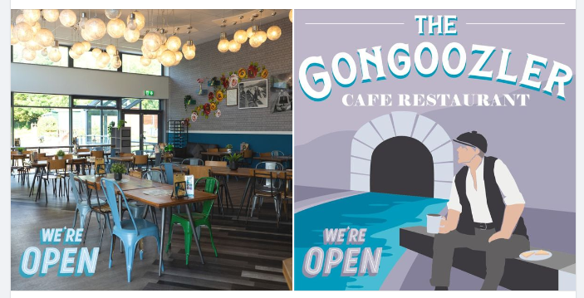
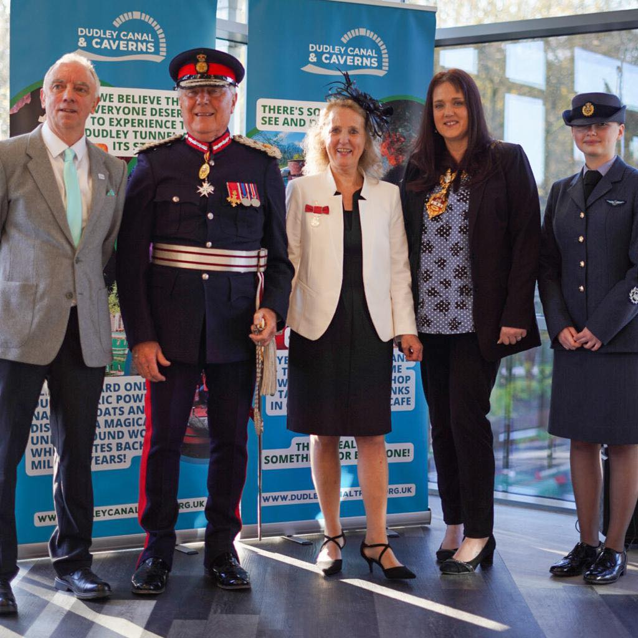

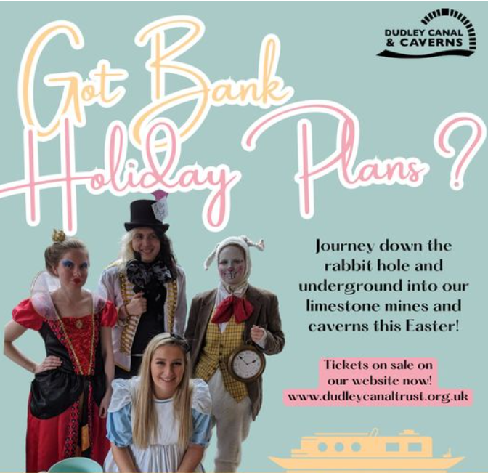
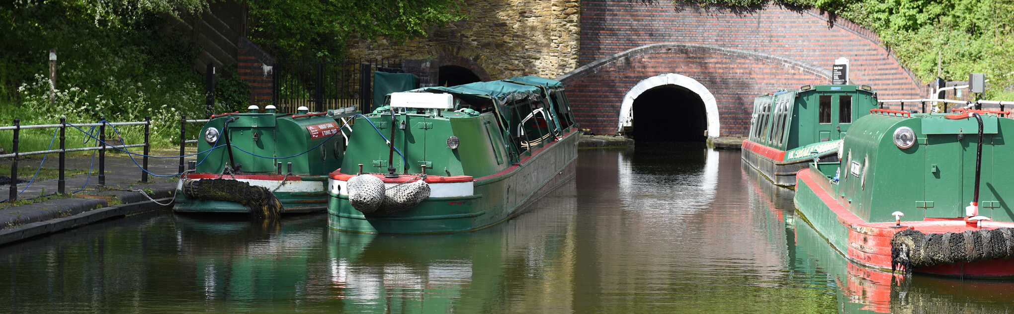
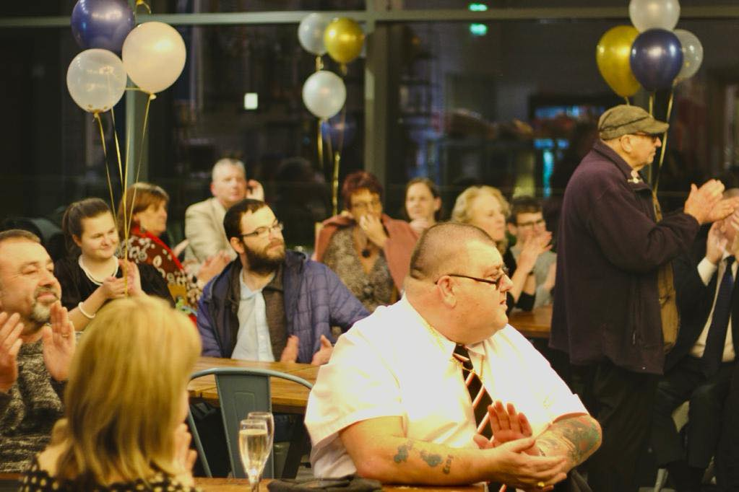
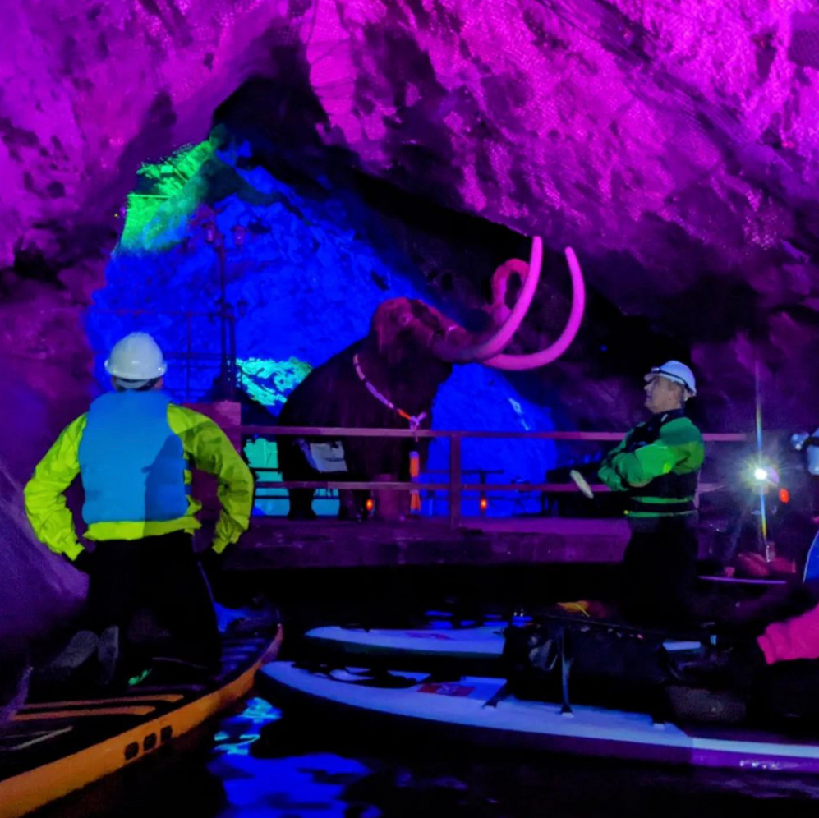

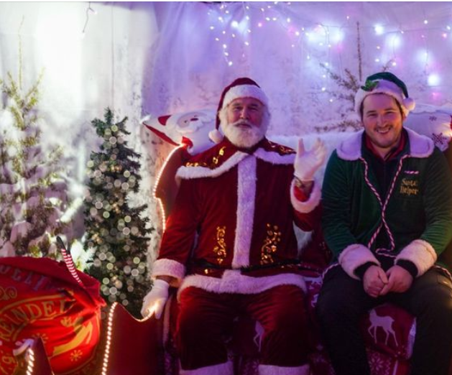
Chief Executive Report
Operational Highlights
Awards and Recognition
Rebranding and Marketing
Challenges

Slide 6

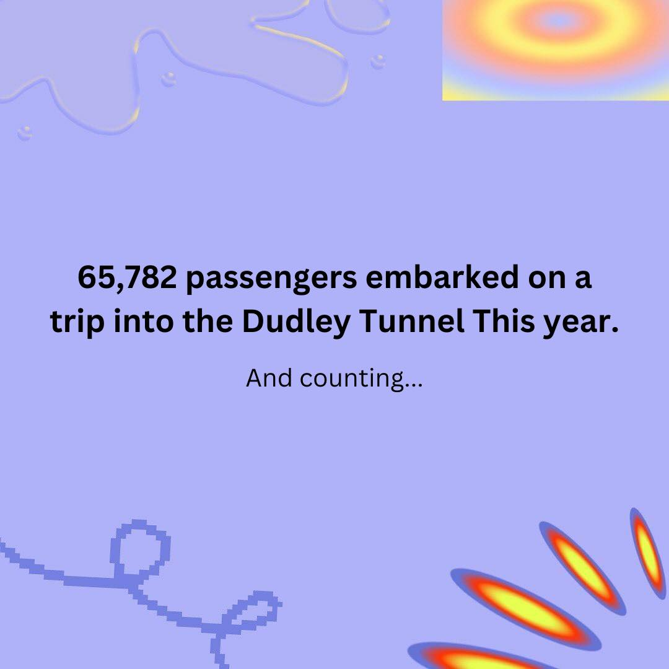


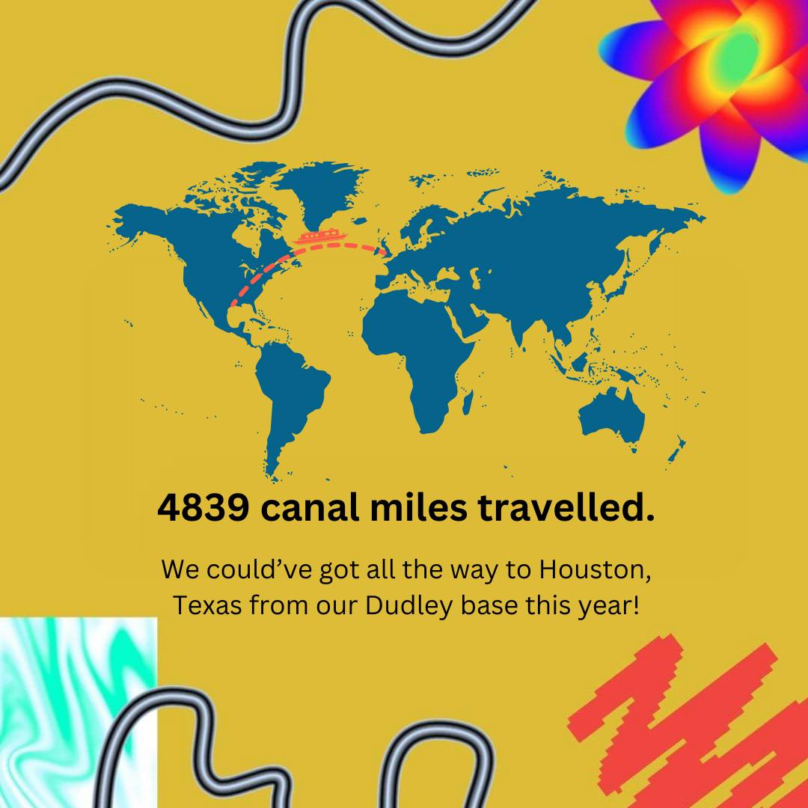
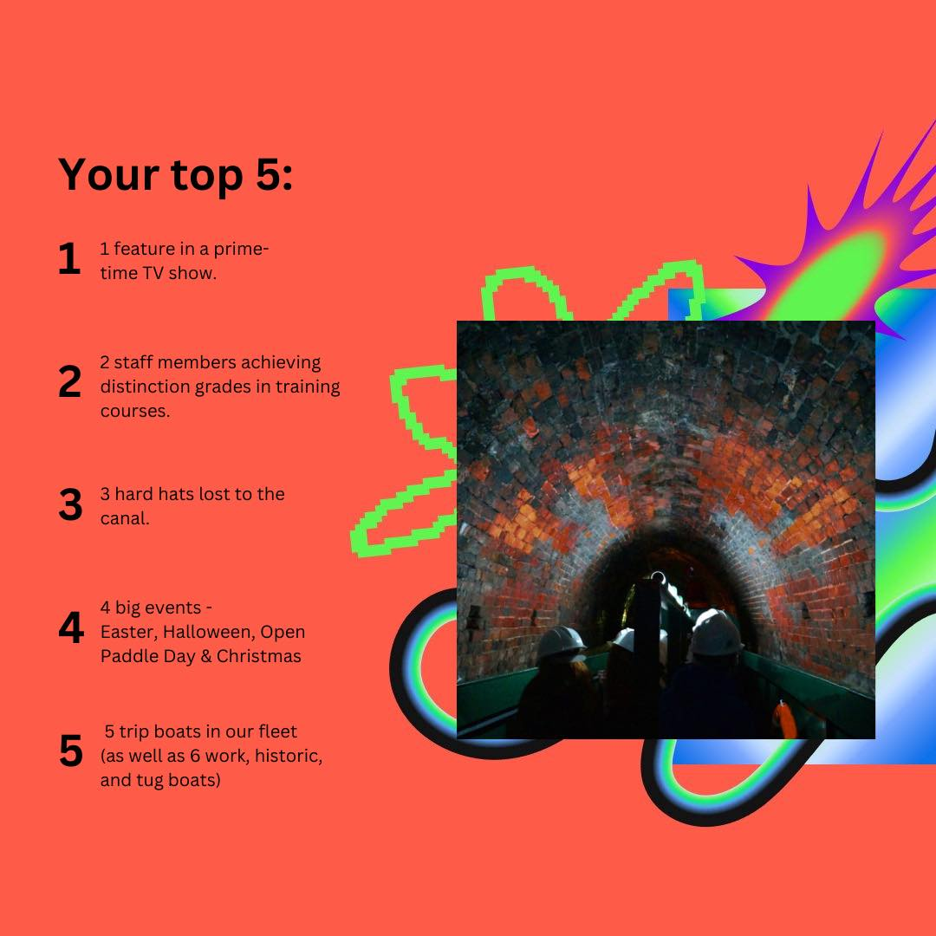
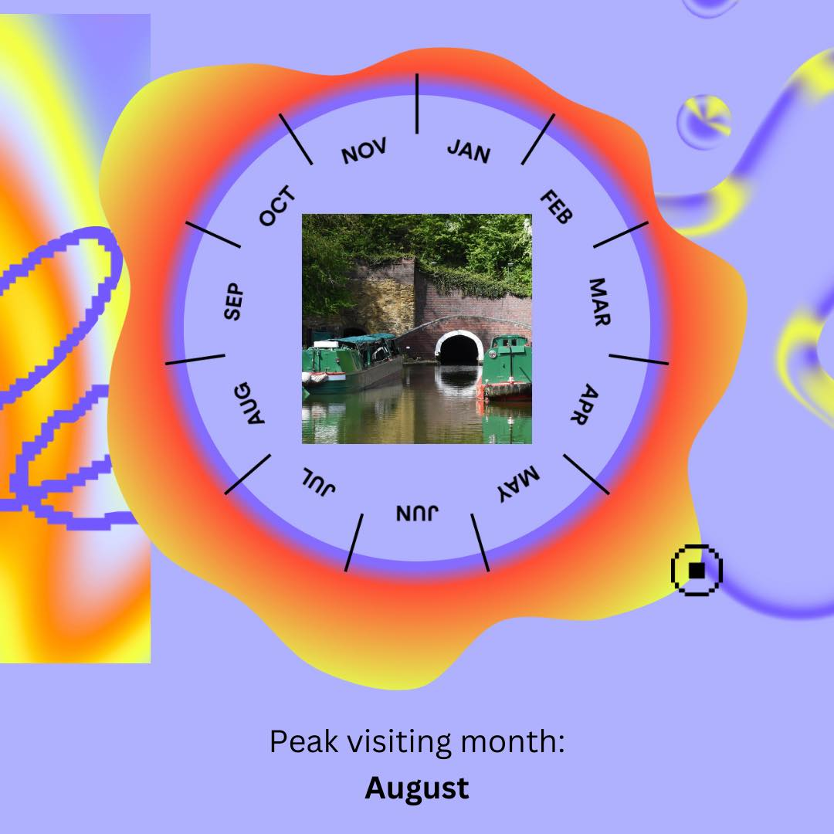
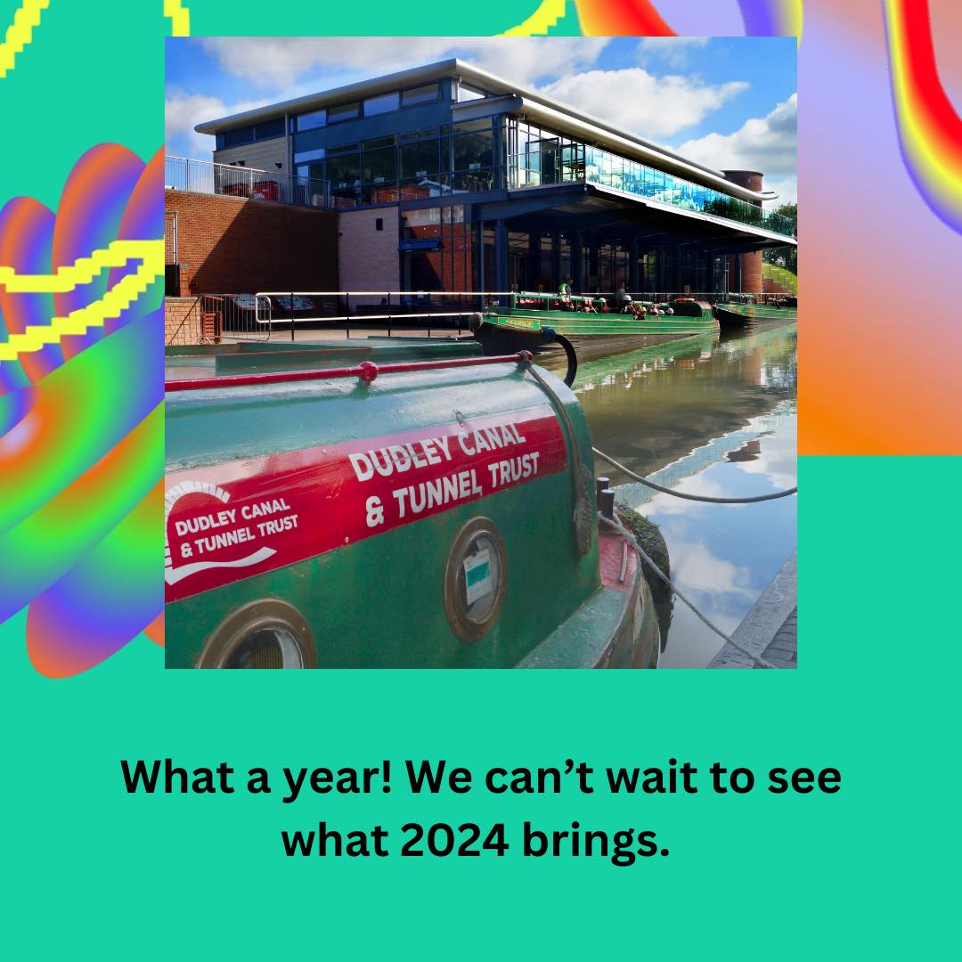
3,200 people had a go at legging in our tunnels

Slide 7
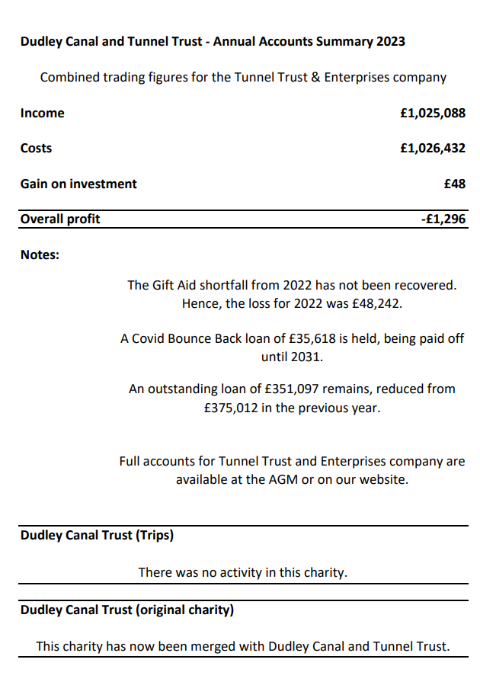
Treasurer’s Report
2023 Annual Accounts
Dudley Canal and Tunnel Trust
Dudley Canal and Tunnel Trust Enterprises Ltd
Dudley Canal Trust Ltd
Treasurer Position

Slide 8
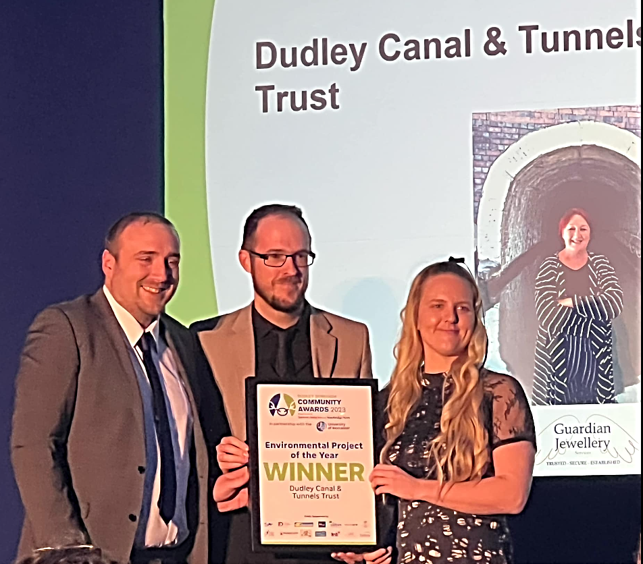

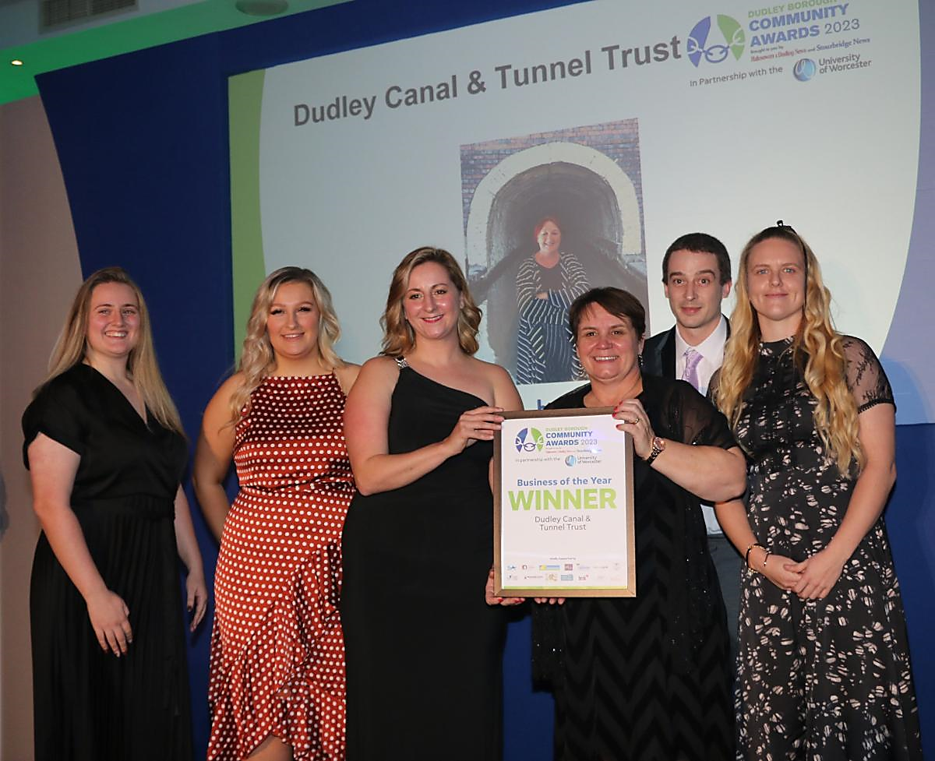
Thank You
Best Environmental Project 2023
Best Business 2023
Finalists EXPRESS & STAR BUSINESS AWARDS 2024

